Slide 1
Cohort Charter Creation: ”Unite” Activity

Slide 2
The Charter is a collaborative document that helps schools establish supportive and productive learning environments. It is created by members of the community, outlining how they aspire to treat each other. Together, the community describes how they want to feel at school, the behaviors that foster those feelings, and guidelines for preventing and managing unwanted feelings and conflict. By working together to build the charter, everyone establishes common goals and holds each other accountable for creating the positive climate they envision.
Teacher facing slide!
Notes:
Tips for All:
This is by no means the only way to write the charter. This lesson plan is to serve as a guide. The goal of the charter is stated in this slide. The outcome of this week is to create a charter with your cohort that is representative of their class and what they want to feel in their class this year.
Writing Tip--As you add a component, you will want to have a place to capture your brainstorm. This could be on chart paper or on a slide, but the teacher should be catching the feelings, actions, conflict ideas and writing out the charter as the cohort builds it daily.
Lower Grade Tips:
You will want to ensure you have ideas ready to go and examples in case students get stuck.
You might want to add visuals as you see fit to support in development.
Key Outcomes:
Charter is developed with homeroom teacher.
Charter visibly lives in classroom space for students to see.
Students hold a personal copy (optional).
Charter is created by end of Week 2.

Slide 3
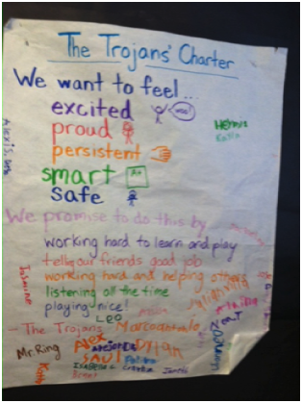
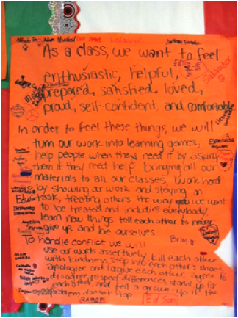
Charter Examples
Teacher facing slide!

Slide 4
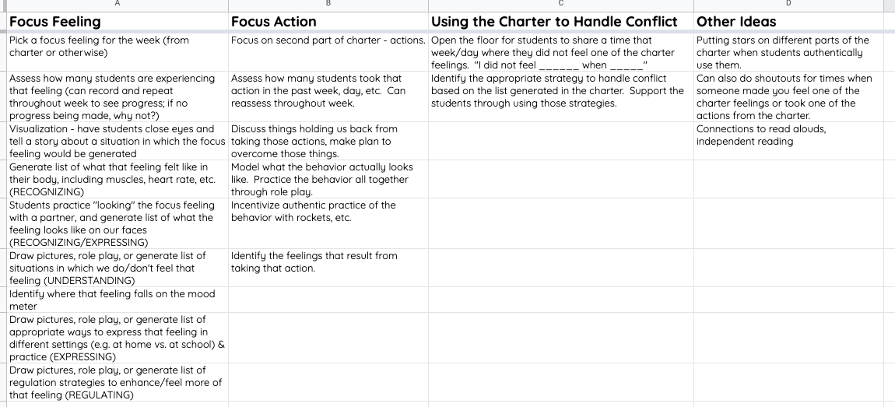
Ways to Keep the Charter Alive
Teacher facing slide!
Notes:
This slide is teacher facing and gives additional ways and ideas to keep the charter alive. You can utilize these during the “connect” or “unite” component of the Community Meeting.

Slide 5
Day 1

Slide 6
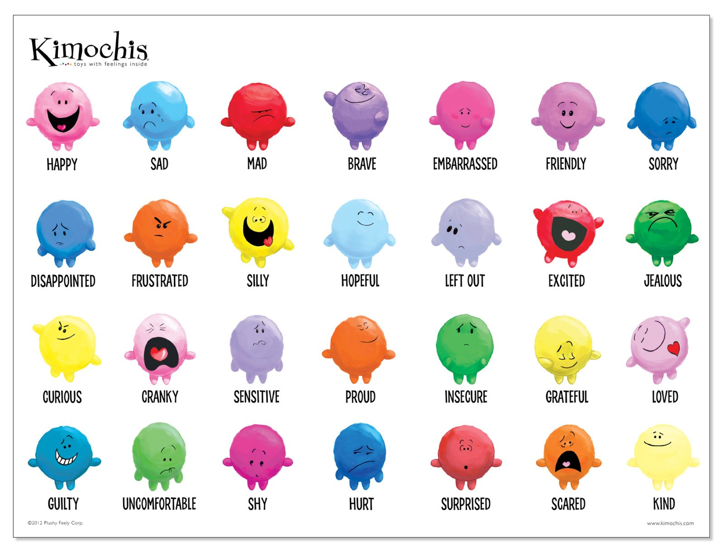
Feelings we want to have as a class.
What are 5 feelings you want to feel this year?
Notes:
Lower Grades (TK-1)
3 minutes students write
2 minutes students share with a partner
5 minutes students share
To Vote: Teachers have students raise their hand or they could utilize stickers/marker to put a mark by their top 5.
*If needed a second round of voting can occur.
Goal: The outcome should be that the cohort aligns on 5 feelings they want to feel this year in class.
Upper Grades (2-5)
1 min. students think in their head/write on paper or whiteboard/other
1 min. turn and talk with a partner
3 mins. brainstorm as a class and create a master list
Encourage them to go beyond "happy". They can draw pictures as well. Share out groups' lists and make a master list as a class, pointing out how they came up with some similar words and some different words.
As a class, determine which feelings from the class are the most important, eliminate ones that might be redundant. Decide on top 5 feelings. Write out first part of charter. ~5 mins.

Slide 7
Feelings we want to have as a cohort.
Vote for your top 5 feelings you want to feel in class.
Notes:
Upper Grades (2-5)-- finishing from Day 1
Teachers have students raise their hand or they could utilize stickers/marker to put a mark by their top 5.
*If needed a second round of voting can occur.
Decide on top 5 feelings. Write out first part of charter. ~5 mins.
Goal: The outcome should be that the cohort aligns on 5 feelings they want to feel this year in class.

Slide 8
Actions we will take.
For each of your 5 feelings, come up with the ACTIONS you will take as a class to help each other feel this way.
Notes:
All Grades
Ask students question 2: what can we do to have these feelings every day and make our classroom a positive place for learning? One feeling at a time, develop master list of behaviors. Remind students behaviors should be specific and clear, and we should be able to see it.
Example: “In order to feel supported, we will ask for and give help to all team members.”
All Grades
You likely will only get to ~2 of the 5 feelings.
Have students partner brainstorm for a feeling for 2 minutes.
Then have the class brainstorm as a group for 3 minutes.
As a class, determine which behaviors are the most important, eliminate ones that might be redundant. Write out second part of charter. Select 1-2 actions for each feeling.

Slide 9
Actions we will take.
For each of your 5 feelings, come up with the ACTIONS you will take as a class to help each other feel this way.
Notes:
All Grades
Finish your remaining feelings today.
Have students partner brainstorm for one feeling for 2 minutes.
Then have the class brainstorm as a group for 3 minutes.
As a class, determine which behaviors are the most important, eliminate ones that might be redundant. Write out second part of charter. Select 1-2 actions for each feeling.
Example: “In order to feel supported, we will ask for and give help to all team members.”
Goal: The outcome should be that the class ends with 1-2 actions for each feeling on how they will ensure each community member feels that way in class.

Slide 10
Day 2

Slide 11
We will prevent and manage conflict by.
What actions will you take to avoid conflict?
Notes:
All Grades
Have students partner brainstorm for 2 minutes.
Then have the class brainstorm as a group for 3 minutes.
As a class, determine which actions are most important, eliminate ones that might be redundant. Select 2-3 ways the class will prevent and manage conflict. 5 minutes
Write out final part of charter.
Goal: The outcome should be that the class ends with 2-3 ways they will prevent and manage conflict this year.
Examples:
Use “I statements with one another”
Use our “disengage stress” coping strategy.
Ask questions before assuming.

Slide 12
Keeping the Charter Alive
All students sign the charter.
Notes:
Ask for proposed amendments, ratify. All students sign. Discuss that class charters will be combined into grade level charters, use of charter as promise like creed. This can also be a source for daily commitments.
All Grades
Have all students sign the charter. (You will want to have the charter printed on a poster. Once all students sign, recommendation is to laminate to ensure it will last all year).
Get creative-- do kids turn it into a chant? A song? Get their input on how to keep it alive and live by it all year.
You can also print a copy for each student that they then decorate and put in their binder.
(see slide 3 for more ideas)

