Slide 1
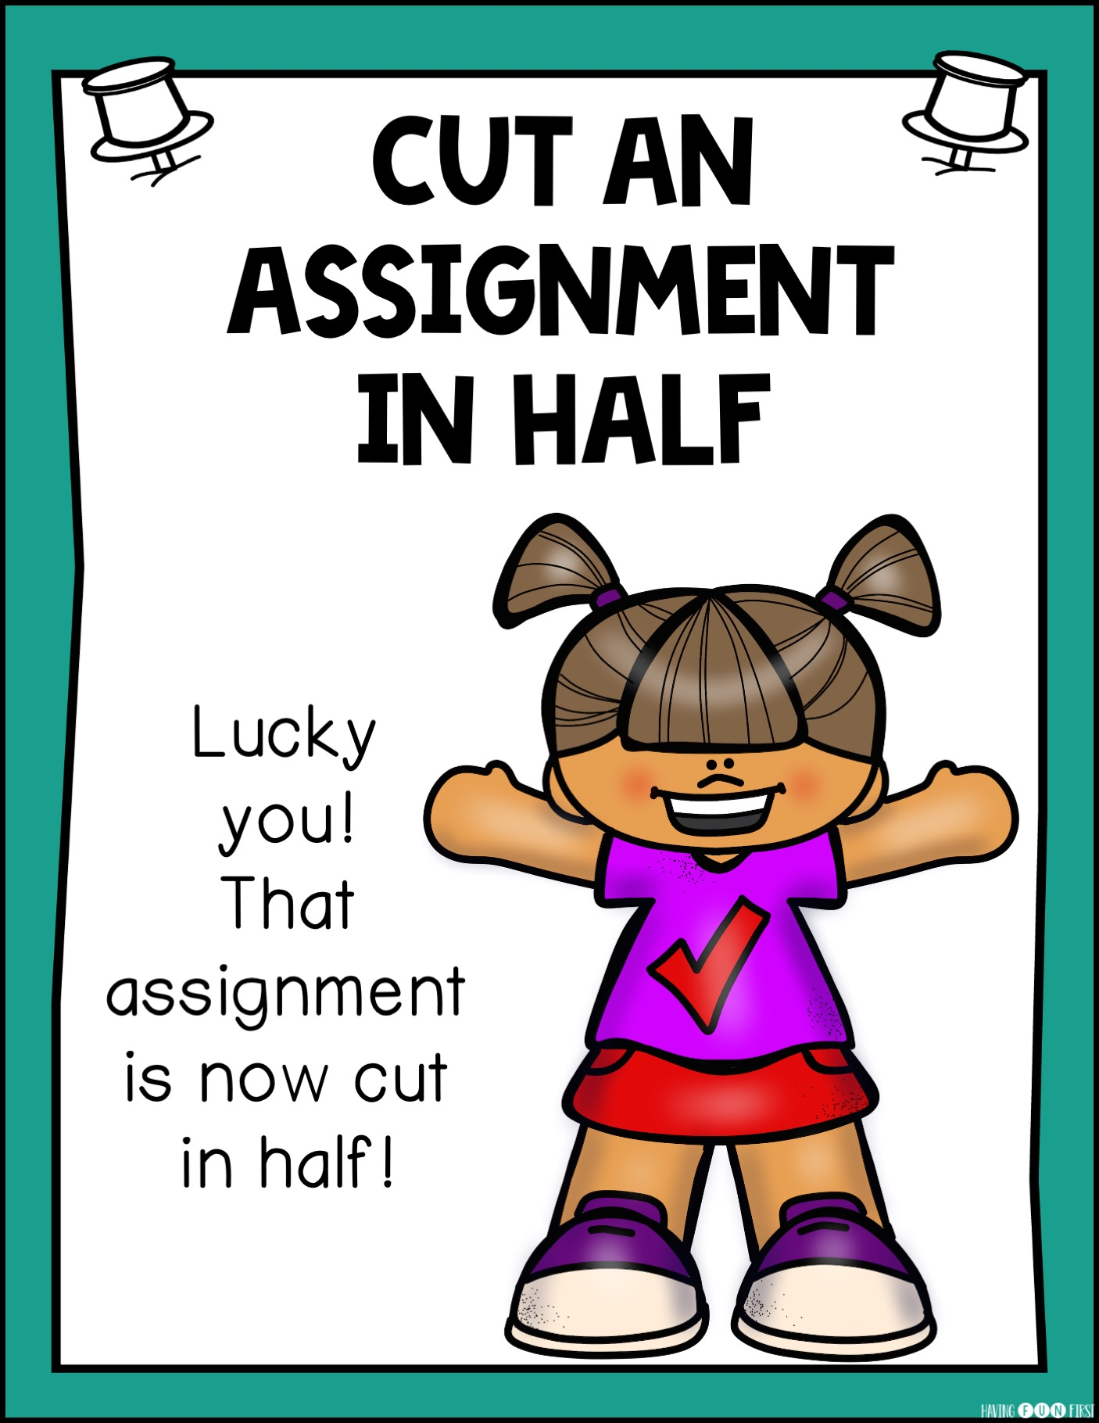
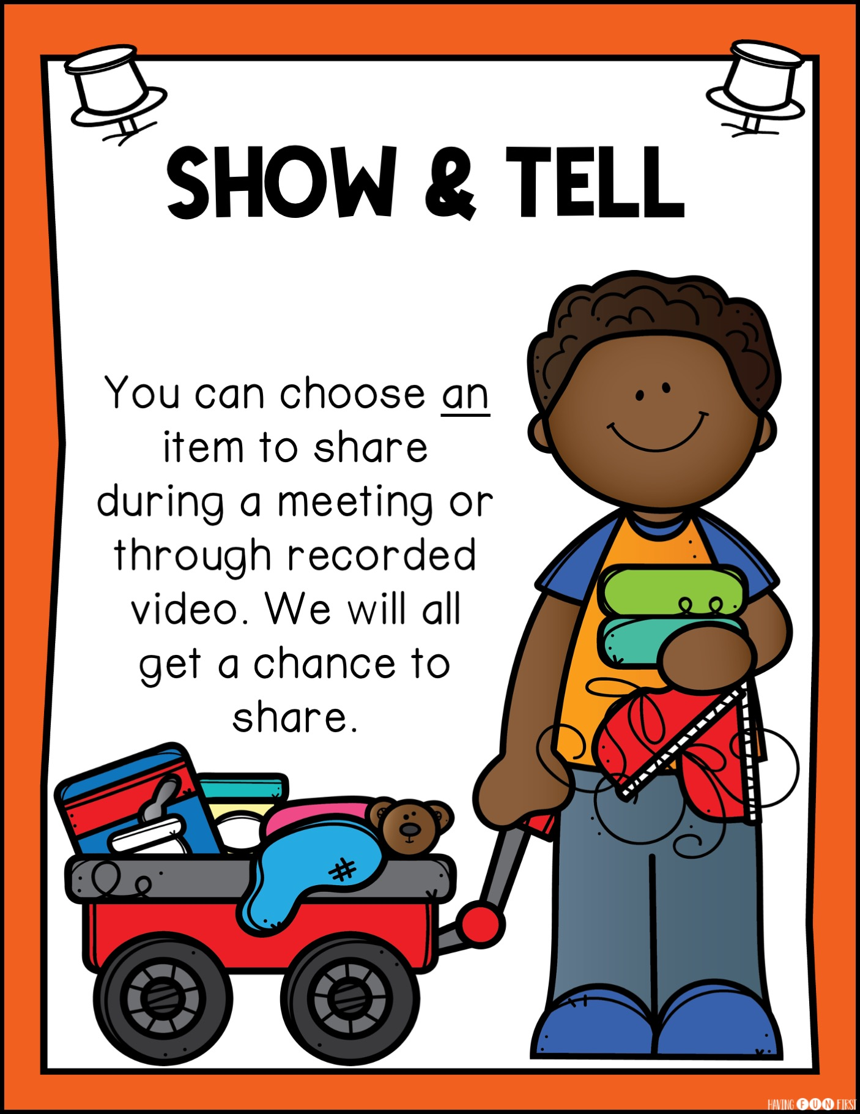
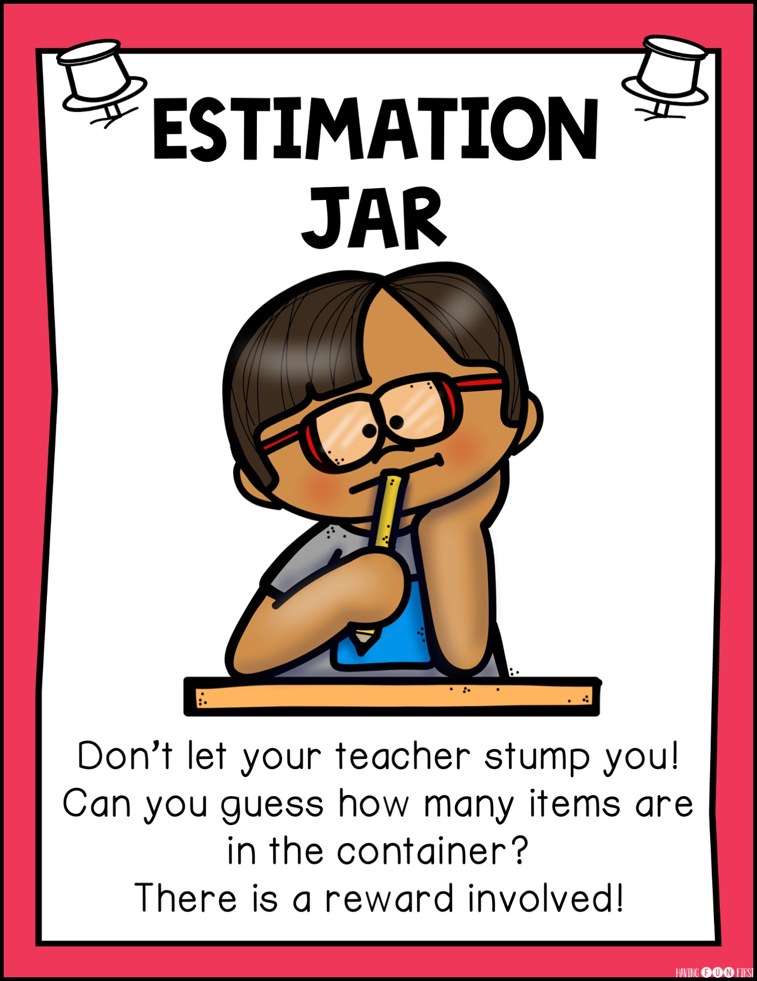
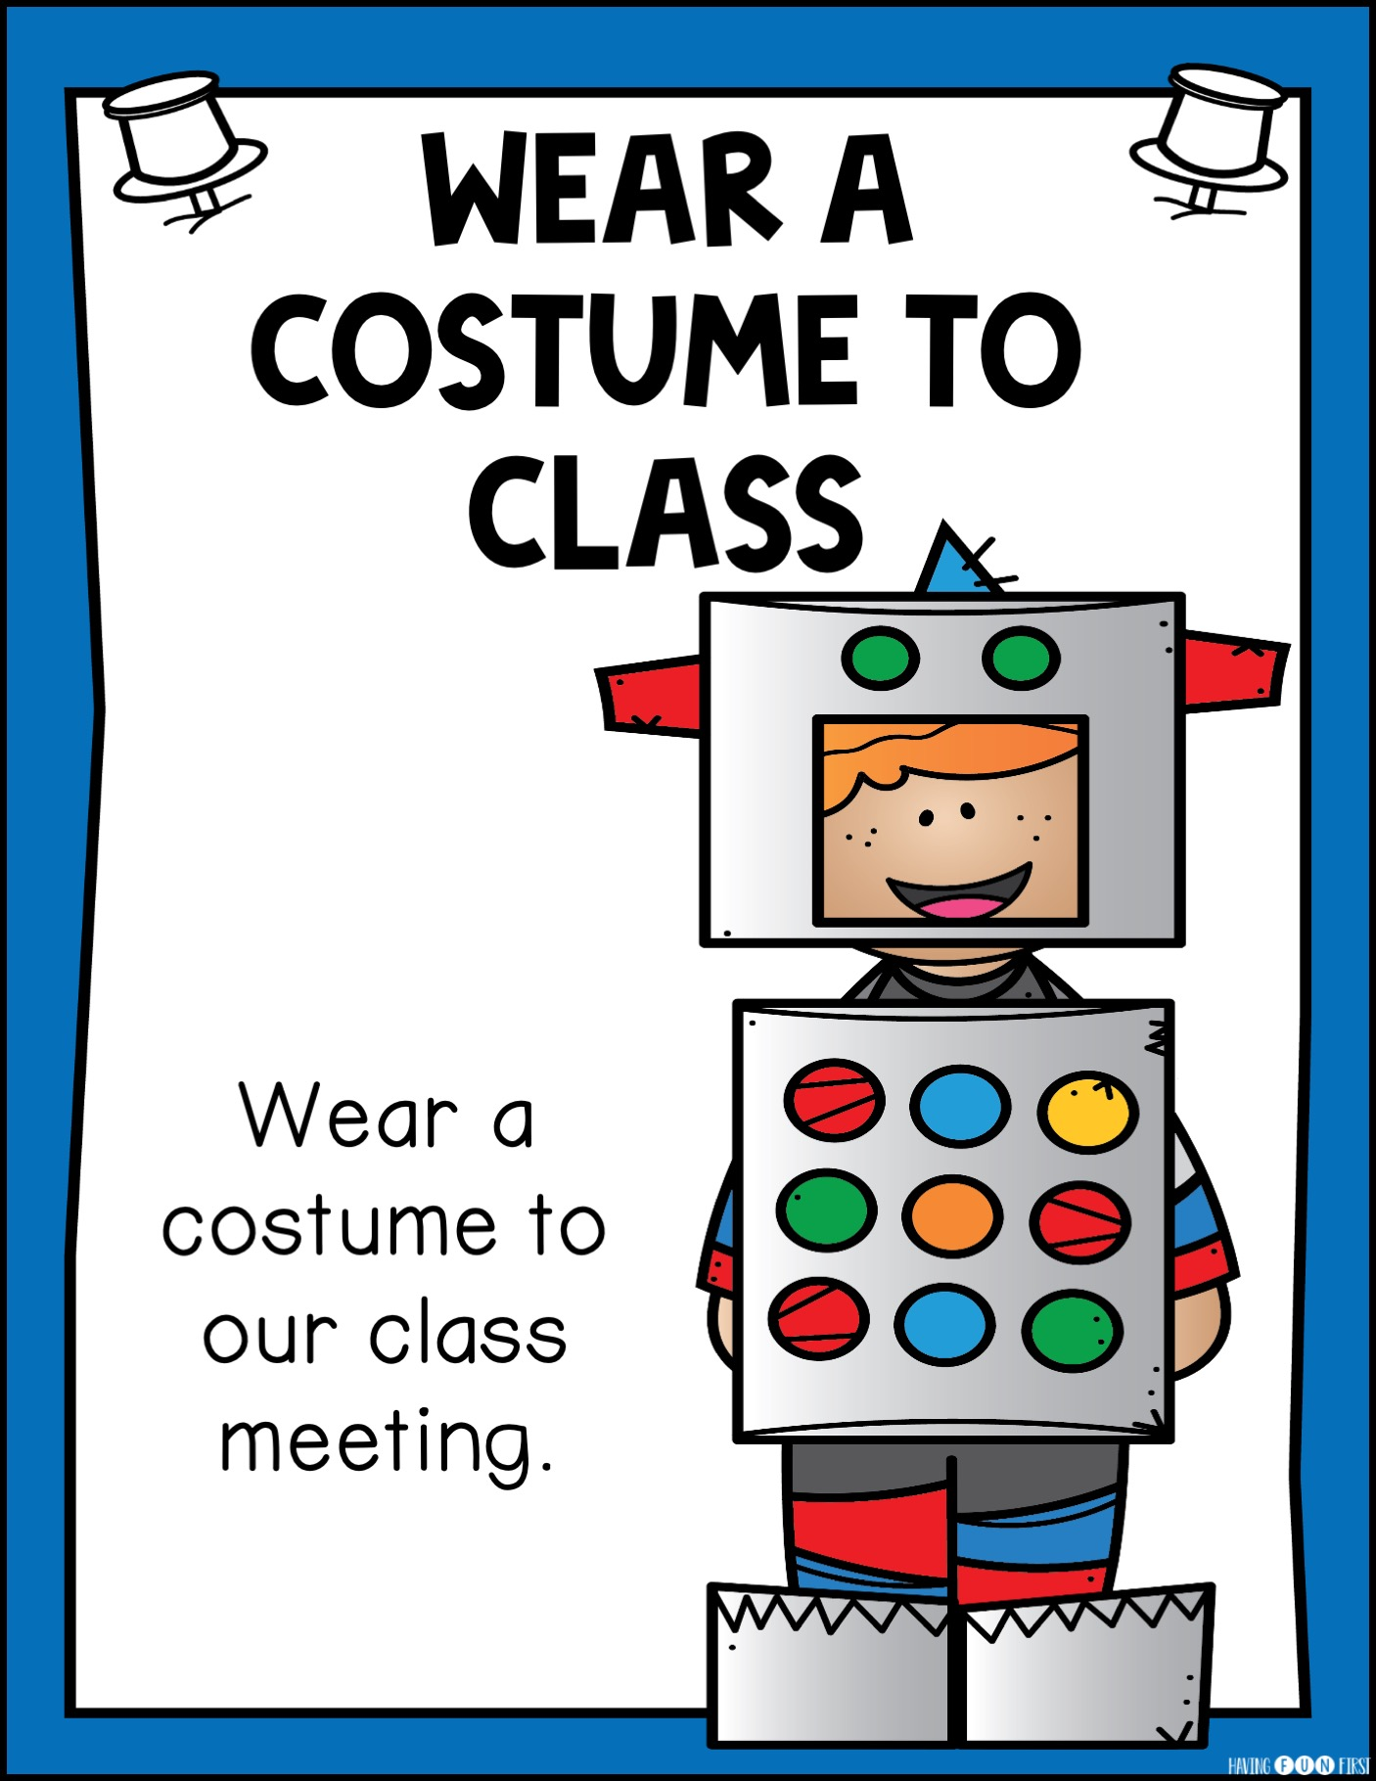
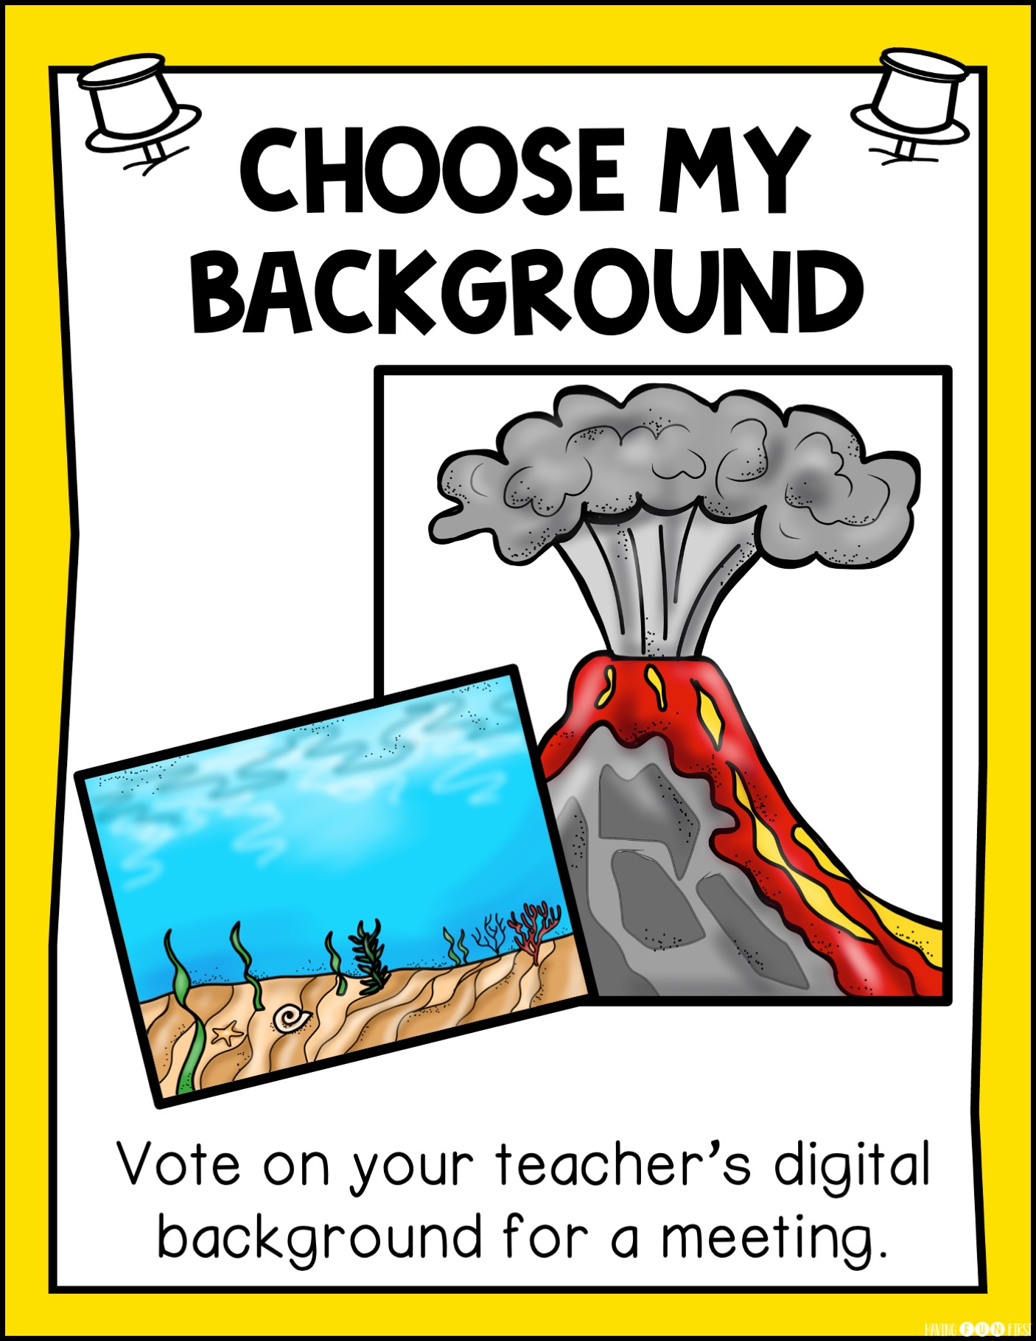
We’re Working For:
8

Slide 2
We’re Working For:
8

Slide 3
TYPE#

Slide 4
TYPE#

Slide 5
TYPE#

Slide 6
TYPE#

Slide 7
TYPE#

Slide 8
TYPE#

Slide 9
TYPE#

Slide 10
TYPE#

Slide 11
TYPE#

Slide 12
TYPE#

Slide 13
TYPE#

Slide 14
TYPE#

Slide 15
TYPE#

