Slide 1
Social Emotional Resources
Practices to center, engage, and lift off

Slide 2
Center
Activities that support presence/connection to mind, body, and soul.

Slide 3
Disengage stress

Slide 4
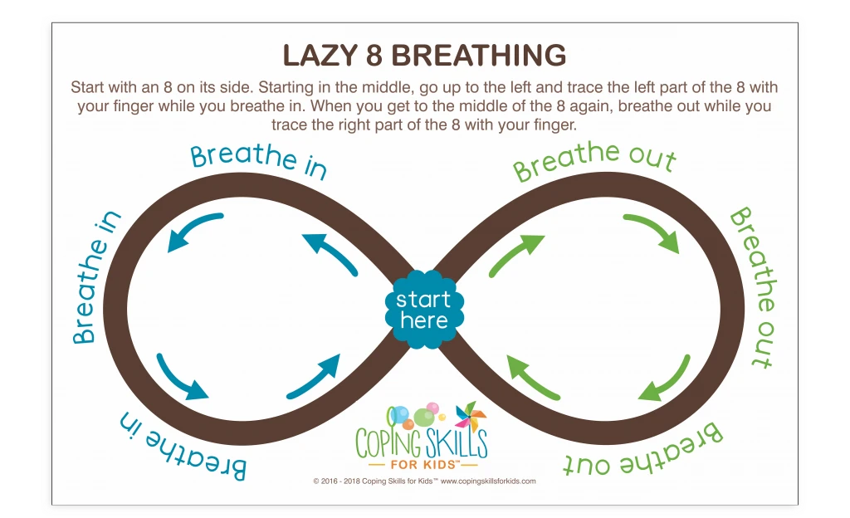

Slide 6
Connect To Your Heart
Take a deep breath in, as you breathe out drag the heart to the middle
Notes:
🍐 This is a Pear Deck Draggable™ Slide.
🍐 To edit the type of question, go back to the "Ask Students a Question" in the Pear Deck sidebar.
--Disengage Stress Activity--
NOTE: This should be quick in the morning. It could be prior to the charter, as students are thinking about their current emotional state, as students are reflecting on their commitment, or at the end of Community Meeting.
Helena-

Slide 7
Feelings Check in:
I feel__________.
I feel this way because…
I feel this in my ________.

Slide 8
Feelings Check in:
I feel__________.
I feel this way because…
I feel this in my ________.

Slide 9
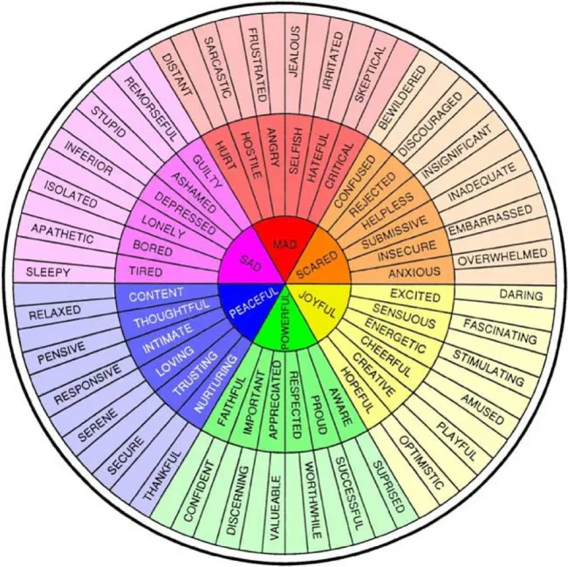
Feelings Check in:
I feel__________.
I feel this way because…
I feel this in my ________.

Slide 10
Engage
Activities that support processing, collaboration, and community building

Slide 11
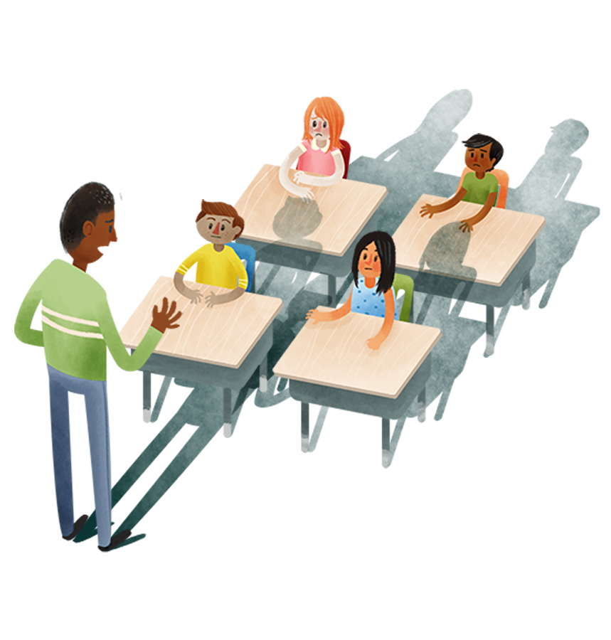
Pear Deck Templates: Discussing Hard Topics with Students
Notes:
Don’t forget to present with Pear Deck!
To install the Pear Deck Add-on for Google Slides go to Add-ons, Get Add-ons and search for Pear Deck.
Accept the permissions and open the Pear Deck Sidebar.
To launch your interactive Pear Deck presentation, click Present with Pear Deck from the Pear Deck Sidebar, this starts a new Session that your students can join from their devices. Learn more at www.peardeck.com
Want to know more about these templates? Check out the accompanying blog post!

Slide 12
Have you, or someone you know, been impacted by the [recent event]?
Yes
No
Notes:
🍐 This is a Pear Deck Draggable™ Slide.
🍐 To edit the type of question, go back to the "Ask Students a Question" in the Pear Deck sidebar.
Please change the question to fit the topic you want to discuss.

Slide 13
How has the [recent event] impacted you or people you know?
Notes:
This is a follow-up question prompting students to explain a bit more about how the current situation is impacting their lives.
If students have been impacted, ask them what they’ve heard.
🍐 This is a Pear Deck Text Slide
🍐 To edit the type of question, go back to the "Ask Students a Question" in the Pear Deck sidebar.

Slide 14
What are two things you’ve heard about the [recent event]?
1.
2.
Notes:
On this slide, students can draw or write 2 things they’ve heard or seen.
🍐 This is a Pear Deck Drawing Slide
🍐 To edit the type of question, go back to the "Ask Students a Question" in the Pear Deck sidebar.

Slide 15
From what sources have you heard about it?
TV
Newspaper
Twitter
Facebook
Youtube
Friends
Parents
Overheard conversations
Other: ___________________
Notes:
This is an opportunity to suss out where students’ information comes from.
Follow-up on this in the following slides.
🍐 This is a Pear Deck Drawing Slide
🍐 To edit the type of question, go back to the "Ask Students a Question" in the Pear Deck sidebar.

Slide 16
Do you trust that source?
Notes:
🍐 This is a Pear Deck Draggable™ Slide.
🍐 To edit the type of question, go back to the "Ask Students a Question" in the Pear Deck sidebar.

Slide 17
What biases might those sources have?
Notes:
🍐 This is a Pear Deck Text Slide
🍐 To edit the type of question, go back to the "Ask Students a Question" in the Pear Deck sidebar.

Slide 18
What emotions do you have about what’s happening?
Notes:
Students might be feeling fear, pain, confusion, guilt, sorrow, anger, indifference. Let them know that any emotion is okay.
🍐 This is a Pear Deck Drawing Slide
🍐 To edit the type of question, go back to the "Ask Students a Question" in the Pear Deck sidebar.

Slide 19
What do you think about what’s going on? What’s your take on it?
Notes:
This is a chance for students to voice their opinions. When you share the answers on the screen, ask students to identify opposing opinions. Ask them if there are opinions that are surprising to them or ones they want to discuss. If you notice that there are opinions that aren’t represented in your class, try to represent them yourself. Be aware of their blind spots and try to open their eyes to different points of view.
🍐 This is a Pear Deck Text Slide
🍐 To edit the type of question, go back to the "Ask Students a Question" in the Pear Deck sidebar.

Slide 20
Leave room for silence
Notes:
When discussing difficult subjects, silence can be very important. Leave room for students to think about the questions, to consider the thoughts of others, and manage their own emotions.

Slide 21
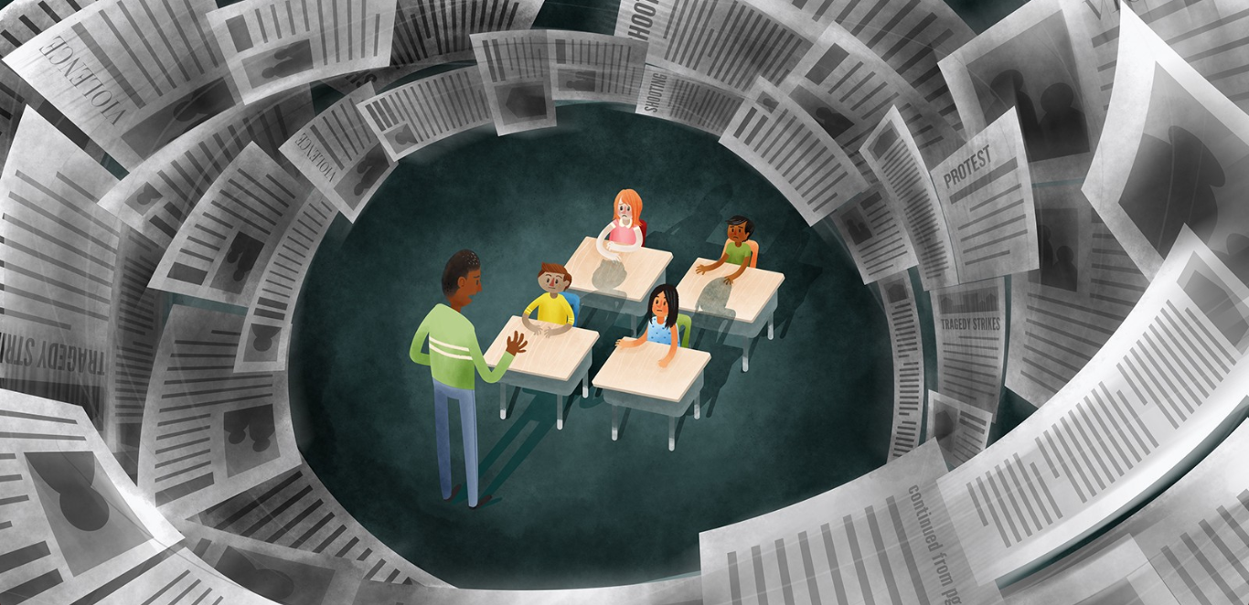
Discussing Hard Topics with Students

Slide 22
Lift Off
Activities that support processing, collaboration, and community building

Slide 23
TODAY I COMMIT TO...
Respect
“Be respectful of your classmates, teachers, and community”
fill in with the example behaviors from your PBIS Handbook
also add examples as your class generates them
Empathy
“Show empathy to others”
fill in with the example behaviors from your PBIS Handbook
also add examples as your class generates them
Persistence
“Be persistent in your work”
fill in with the example behaviors from your PBIS Handbook
also add examples as your class generates them
Responsibility
“Be responsible for your actions”
fill in with the example behaviors from your PBIS Handbook
also add examples as your class generates them
5th CV
“Fill in from PBIS Handbook”
fill in with the example behaviors from your PBIS Handbook
also add examples as your class generates them
Notes:
--Commit Activity--
NOTE: The goal of this slide is to be a scaffold for those who need support coming up with a commitment for the day. It should be up during breakfast for students to reference. The examples under the core values should be generated from the school PBIS Handbook, as well as, from students as they come up with ways to show the core value in the classroom.

Slide 24
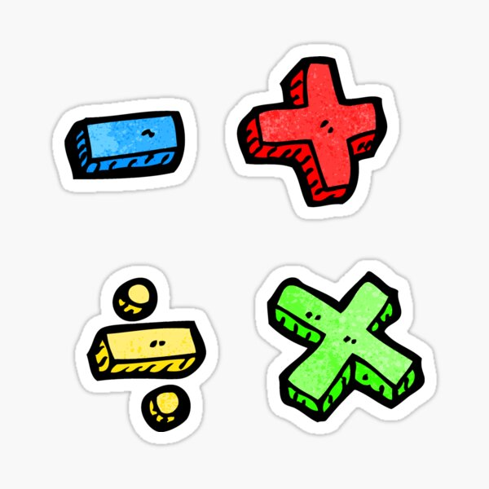
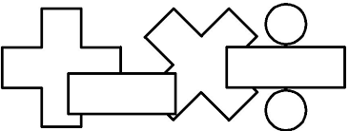
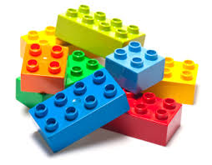
Week Of: August 17-21
Community Meeting | Charter Creation: Feelings | Charter Creation: Feelings | Charter Creation: Actions | Charter Creation: Actions | Charter Creation: Signing
STEM | Unit 1 Begins | Adding using place value discs | Adding using place value discs | Adding using place value discs | Adding on a number line
HUMANITIES | Unit 1 Begins | Wonder: Character Feeling | Wonder: Character Feeling | Wonder: Character Perspective | Substitute Teacher Ms. C. Absent
LL | Legos | Lexia and ST Math | Sportsmanship | Legos | Fun Friday
Enrichment | PE | PE | ART | SCIENCE | ART
Notes:
--Trauma Informed Practice--
NOTE: You should order the blocks in the order that the students follow (i.e. if they have LL first it should be first on the schedule).
As a grade level, you could align on this slide and then each teacher would be responsible for updating their content area each week.

