Slide 1
Being a Friend Online
Digital Citizenship
August 28, 2020

Slide 2
What is a COMMUNITY?
Notes:
Ask students this simple question
Try to help students think about emotional safety as well as physical safety. Explain to your students that today, you will be thinking about how to be inclusive and how to show empathy in communities.
Ask your students, “What has been a time you have felt included in a community?” List their ideas about what makes a person feel included or not. Explain that being inclusive is making others feel included, welcome or like they belong.
As you talk about inclusivity, ask students to focus on times that they have felt included in a group and times they have felt left out. You can use these experiences to help them start thinking about what it means to include others.

Slide 3
I can be inclusive by...
Notes:
Write down their ideas as a list (Zoom annotation)

Slide 4
Let’s read a story.
Notes:
Today, we are going to read a story. While I’m reading, you can follow along on the screen, or just close your eyes and make a mind movie. After we’ve read it, we will have a discussion.

Slide 5
Being a Friend Online
It was a rainy day, and Allie was hanging out with her best friend Susan. They didn’t have much to do, and Susan told Allie, “I’m getting bored. Your house is kind of boring.” Allie did not want Susan to get bored, so she suggested they look on the iPad. Allie’s parents said that was okay as long as it was only for one hour. Susan knew how to do lots of things Allie did not know about on the tablet! She showed Allie some things that Allie had heard her parents talk about, like Facebook and Pinterest. She also showed Allie ways to watch different videos that some of their classmates posted and how to look at their pictures on Instagram.
Allie was starting to feel like Susan knew everything, and she didn’t know anything! She wanted Susan to see that she was cool, too. Then, Allie noticed that their friend Lyn had an Instagram account. Allie could not even believe it. Lyn was usually the last to do everything. “Let’s look at Lyn’s pictures,” Allie suggested to Susan. They found lots of pictures of Lyn doing silly things with her family, making food that looked gross to Allie, and even just celebrating holidays. Then, Allie noticed
that there was a place to write comments about the pictures. Allie grabbed
the iPad from Susan. “What an ugly bunch of freaks,” she typed.

Slide 6
She figured it did not matter what she said, since Lyn would never know who had written the comment. Susan grabbed the iPad back before Allie had the chance to post the comment. “What are you doing, Allie?” she exclaimed. “Lyn is part of our community! How do you think she would feel after reading a comment like that?”
Allie thought about it. She felt her skin crawl, imagining Lyn’s feelings. “You’re right,” she said to Susan, “the Internet is for everyone.” She looked at her friend and spoke honestly, “I was just feeling left out, and I wanted you to think I was cool.”
Fitting in is complicated when it comes to the Internet,” Susan said, “But sometimes I ask myself, ‘How would I feel if someone said that to me in person?’ Then I can think about how it would feel to read a comment like that on-line.”

Slide 7
Let’s reflect.
Notes:
When were the characters being inclusive?
How did the characters show empathy in this story?
What experiences of your own does this story remind you of?
What can kids do to make their communities stronger?
What are some of the different ways iPads, computers and phones can help and harm a feeling of community?
After reading this story, would we add anything to our “ I can be inclusive by” list?

Slide 8
What should we do if we see someone is not safely engaging in their online community?
Notes:
Now that we’ve discussed the potential dangers of our actions online, we need to think about what we can do when we see someone taking actions that are harmful to others. What can we do?
Have a discussion.
Stamp key points that have come up in discussion.

Slide 9
I can be inclusive by...
Notes:
Let’s go back to this list and share again.. What actions can we take to be inclusive of others.

Slide 10
What expectations can we make for our own digital communities?

Slide 11
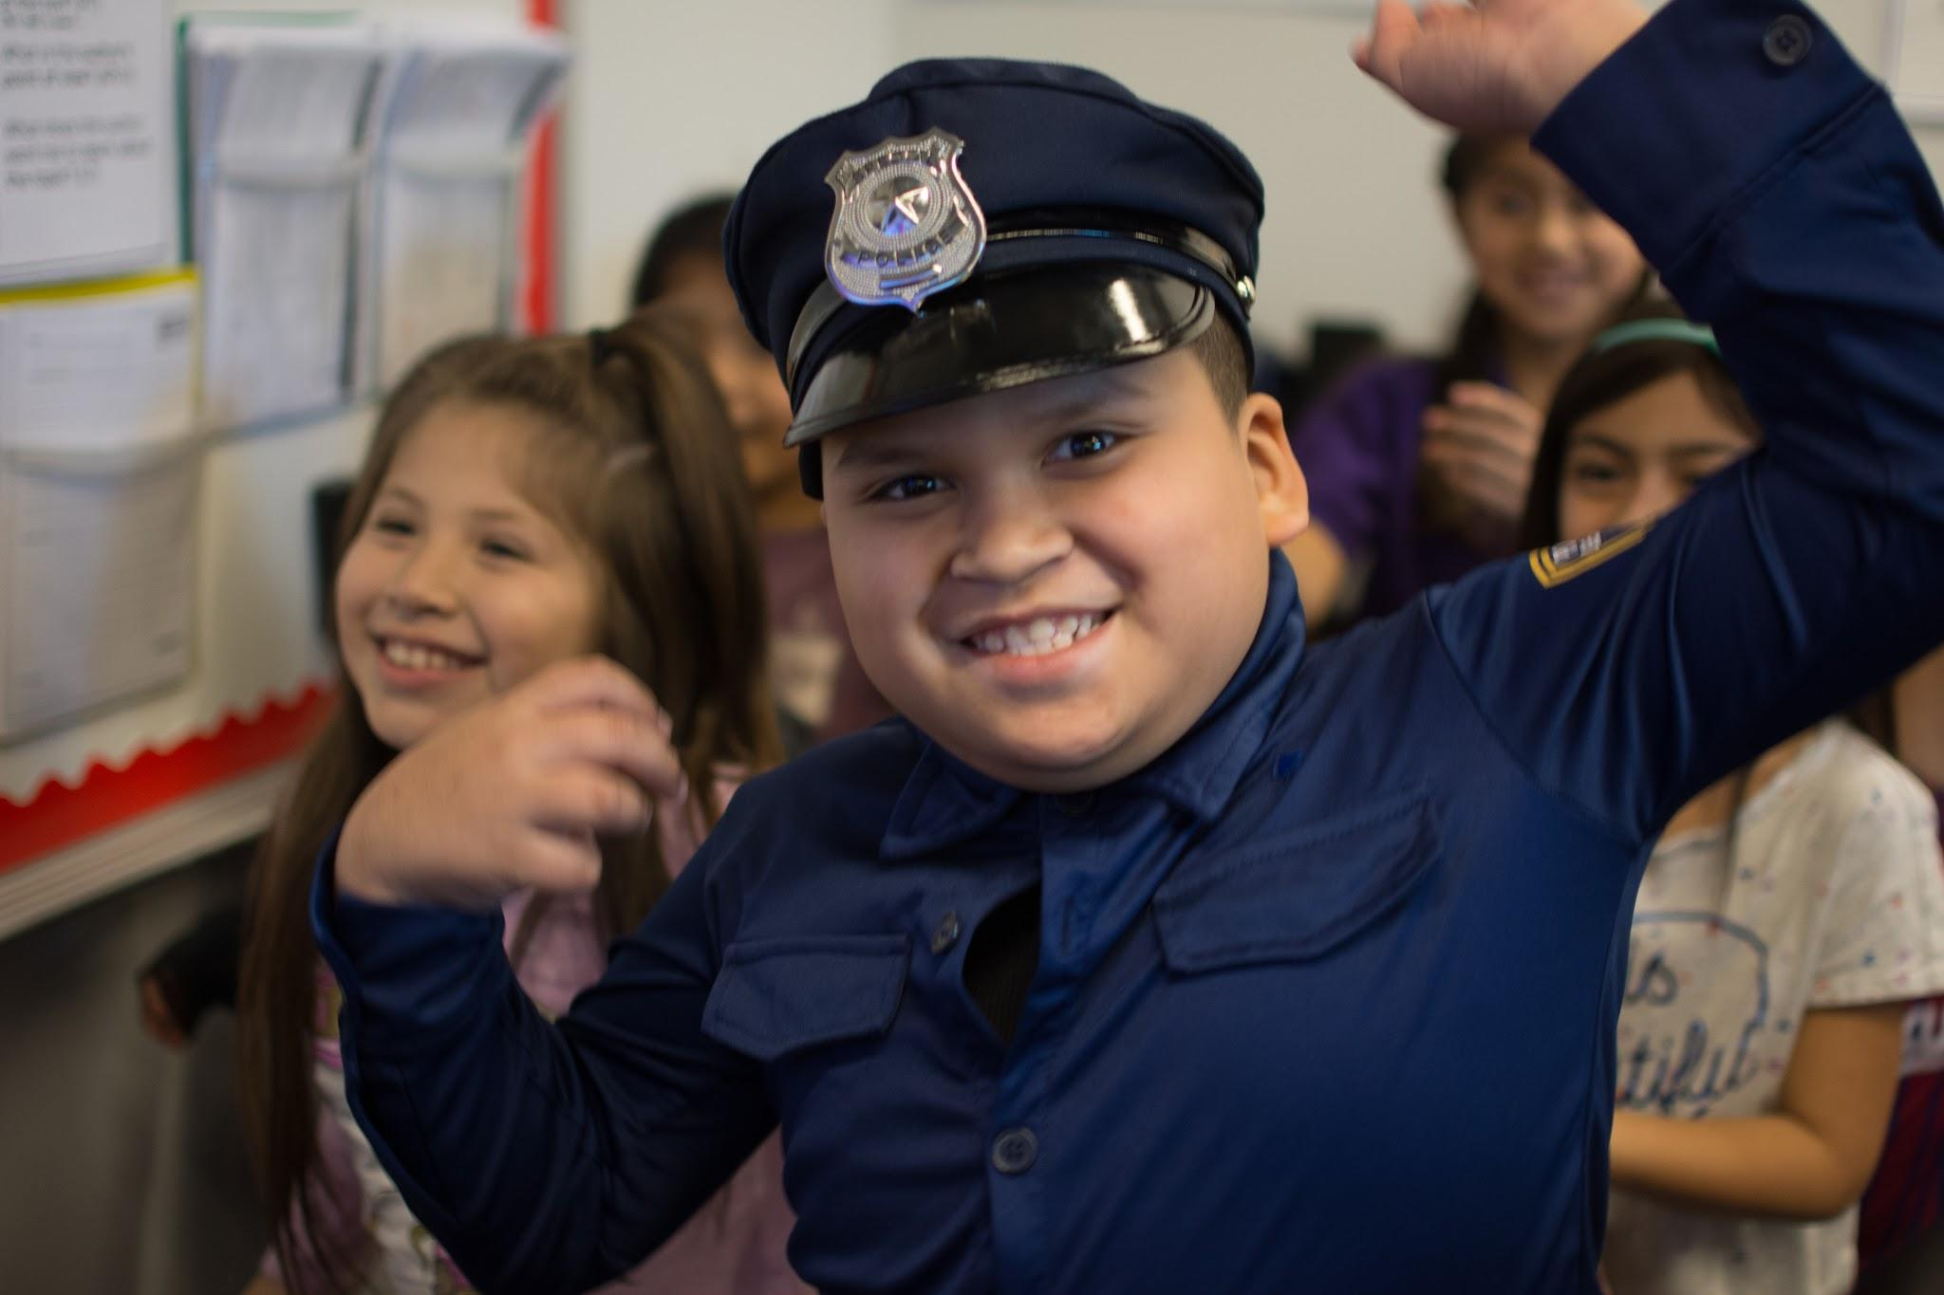
We are a community.
Notes:
So remember Rocketeers, even though we’re not physically in a classroom community, we are still part of a digital community. And the way we treat each other will make a very big impact on the way we learn.

